Slide 1












EMOTION DETECTION

Slide 2








TEAM
2103A51456-D.SRI DEEKSHITHA
2103A51473-MAHVISH ISHAQ
2103A51179-NASHEER FATIMA

Slide 3




TABLE OF CONTENTS
1—INTRODUCTION
ABSTRACT
IMAGES
DATA CONVERSION
CODE
LEARNING MODEL
CONCLUSION

Slide 4
1. INTRODUCTION
If someone showed you a picture of a person and asked you to guess what they’re feeling, chances are you’d have a pretty good idea about it. What if your computer could do the same? Face detection has been around for ages. Taking a step forward, human emotion displayed by face and felt by brain, captured in either video, electric signal (EEG) or image form can be approximated. Human emotion detection is the need of the hour so that modern
artificial intelligent systems can emulate and gauge reactions from face. This can be helpful to make informed decisions be it regarding identification of intent, promotion of offers or security related threats. Recognizing emotions from images or video is a trivial task for human eye, but proves to be very challenging for machines and requires many image processing techniques for feature extraction. Several machine learning algorithms are suitable for this job. Any detection or recognition by machine learning requires training algorithm and then testing them on a suitable dataset. This paper explores a couple of machine learning algorithms as well as feature extraction techniques which would help us in accurate identification of the human emotion.

Slide 5
2. ABSTRACT
Human emotion detection is implemented in many areas requiring additional security or information about the person. It can be seen as a second step to face detection where we may be required to set up a second layer of security, where along with the face, the emotion is also detected. This can be useful to verify that the person standing in front of the camera is not just a 2-dimensional representation. Another important domain where we see the importance of emotion detection is for business promotions. Most of the businesses thrive on customer responses to all their products and offers. If an artificial intelligent system can capture and identify real time emotions based on user image or video, they can make a decision on whether the customer liked or disliked the product or offer. We have seen that security is the main reason for identifying any person. It can be based on finger-print matching, voice recognition, passwords, retina detection etc. Identifying the intent of the person can also be important to avert threats.
This can be helpful in vulnerable areas like airports, concerts and major public gatherings which have seen many breaches in recent years. Human emotions can be classified as: fear, contempt, disgust, anger, surprise, sad, happy, and neutral. These emotions are very subtle. Facial muscle contortions are very minimal and detecting these differences can be very challenging as even a small difference results in different expressions. Also, expressions of different or even the same people might vary for the same emotion, as emotions are hugely context dependent . While we can focus on only those areas of the face which display a maximum of emotions like around the mouth and eyes, how we 2 extract these gestures and categorize them is still an important question. Neural networks and machine learning have been used for these tasks and have obtained good results.

Slide 6
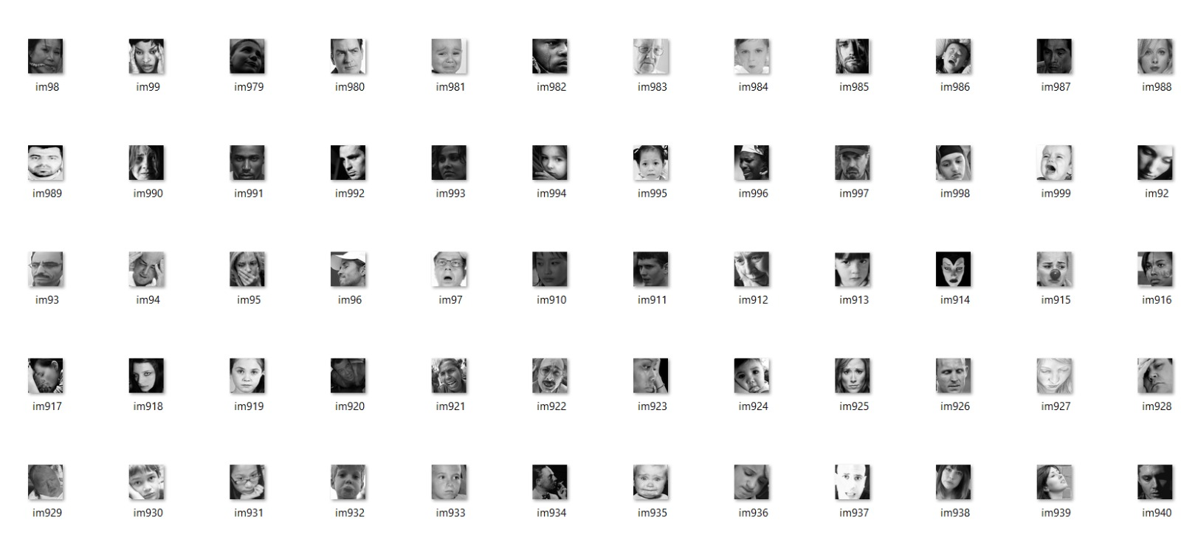
3. IMAGES

Slide 7
DATA CONVERSION
04.
Data conversion from image data to an array is an important preprocessing step in many machine learning and computer vision applications. When working with images, we typically represent them as matrices of pixel values. However, machine learning algorithms require numerical data in the form of arrays or tensors to be able to process the data effectively. One common method of converting image data to an array is by using OpenCV, an open-source computer vision library. OpenCV provides a range of functions to load, process, and manipulate image data in a variety of formats. To convert an image to an array using OpenCV, we first load the image using the imread() function. This function reads the image and returns a numpy array representation of the image in BGR format. We display the image by using pyplot() module we use imshow function from it.

Slide 8
5.CODE
import cv2
import numpy as np
import os
labels =['happy','sad']
img_size=200
def get_training_data(data_dir):
data=[]
for label in labels:
path=os.path.join(data_dir,label)
class_num=labels.index(label)
for img in os.listdir(path):
try:
img_arr=cv2.imread(os.path.join(path,img),cv2.COLOR_BAYER_GB2RGB)
resized_arr=cv2.resize(img_arr,(img_size,img_size))
data.append([resized_arr,class_num])
except Exception as e:
print(e)
return np.array(data)

Slide 9
6. LEARNING MODEL
HAPPY
SAD
Supervised learning, also known as supervised machine learning, is a subcategory of machine learning and artificial intelligence. It is defined by its use of labeled datasets to train algorithms that to classify data or predict outcomes accurately. As input data is fed into the model, it adjusts its weights until the model has been fitted appropriately, which occurs as part of the cross validation process. Supervised learning helps organizations solve for a variety of real-world problems at scale, such as classifying spam in a separate folder from your inbox.
The Classification algorithm is a Supervised Learning technique that is used to identify the category of new observations on the basis of training data. In Classification, a program learns from the given dataset or observations and then classifies new observation into a number of classes or groups. Such as, Yes or No, 0 or 1, Spam or Not Spam, cat or dog, etc. Classes can be called as targets/labels or categories.

Slide 10

METHODOLOGY: 1.Logistic Regression: Logistic regression is a statistical method used for binary classificaton problems it works by fitting logistic functions to the input variables,which transfers the input variables into a range between 0 and 1.The output of a logistic regression is binary value.
Accuracy: 0.6628527841342486

Slide 11

2.Decision tree: A decision tree algorithm that is used for both classification and regression problem it works by recursively partitioning the data into subsets based on the values of input features the algorithm starts by selecting the best feature to split the data into groups once the tree is bulit new instances can be classified by traversing the tree from the root node to leaf node based on the values of input.
Accuracy: 0.6292906178489702

Slide 12

3.KNN: The k nearest neighbours(K-NN) algorithm is a type of supervised machine learning it is used for both classification and regression. The KNN algorithm works by finding the k nearest data points to a given test point uses the class label to predict the class of the test point it is used to measure similarity between data points by euclidean distance.
Accuracy: 0.6193745232646835

Slide 13
4.Random Forest: “Random Forest is a classifier that contains a number of decision trees on various subsets of the given dataset and takes the average to improve the predictive accuracy of that dataset." Instead of relying on one decision tree, the random forest takes the prediction from each tree and based on the majority votes of predictions, and it predicts the final output. From sklearn.ensemble import RandomForestClassifier
Random Forest accuracy: 0.7170099160945843

Slide 14

5.Support vector machine: Support Vector Machine (SVM) is a powerful algorithm used in machine learning for classification and regression tasks. The goal of SVM is to find the best possible boundary that separates the data into different classes. This boundary is called a hyperplane, which can be linear or non-linear, depending on the type of SVM used.
Accuracy: 0.7299771167048055

Slide 15
CONCLUSION
07.
The stages of the process into the infinite possibilities of machine learning for emotion detection applications, complete with case studies.
The trained models can be used to detect facial emotions automatically.
As a result,emotion linked applications such as depression tackler could be adopted faster. This research could help with early and automated emotion.The proposed structure can be combined with a feedback system that provides appropriate insights, treatments, acknowledgements and control techniques in regard to the individual’s mood.

Slide 16
THANK YOU!

